Slide 1

University Institute of Engineering
DEPARTMENT OF COMPUTER SCIENCE & ENGINEERING
Bachelor of Engineering (Computer Science & Engineering)
Subject Name:Computer Network
Subject Code: 21CSH-256/ 21ITH-256
DISCOVER . LEARN . EMPOWER

Slide 2
Syllabus
UNIT-I
Introduction: Introduction to network, types of transmission technologies, Network Categories: LAN, MAN, WAN (Wireless /Wired), Network Software: Concept of Layers, Protocols, interfaces and services. Reference Models: OSI, TCP/IP and comparison, Concept of Topologies.
Physical Layer: Bit rate, Baud rate, Bandwidth, Transmission Impairments: Attenuation, Distortion, Noise; Data rate limits: Nyquist formula, Shannon Formula, Modulation & modems; Transmission Modes, Multiplexing: Frequency Division, Time Division, Wavelength Division; Transmission Media: Twisted pair, coaxial, fiber optics, Wireless Transmission (radio, microwave & infrared);Message switching, Circuit Switching & Packet Switching. UNIT-II
Data Link Layer: Design issues, Error Detection & Correction; Flow control & Error Control; Sliding Window Protocols, ARQ: Stop & Wait , Go Back n, Selective Repeat ; Examples of DLL protocols – HDLC, PPP; Medium Access Sub layer: Channel Allocation; Random Access: ALOHA, CSMA protocols; Controlled Access: Polling, Reservation, Token Passing; Examples of IEEE standards(802.2,802.3,802.4, 802.5), Basics of Wi-Fi(802.11).Network Layer: Design issues, Logical Addressing: IPv4 & IPv6; Packet Formats & their comparison IPv4 & IPv6; Routing Algorithms: Distance Vector, Link State
UNIT-III
Network Layer(Continue): Congestion Control: Principles of congestion control; Congestion prevention policies, Leaky bucket & Token Bucket Algorithms.
Transport Layer: Services provided to upper layers, Elements of Transport protocols. Addressing, Flow Control & buffering; Example Transport protocols: TCP, SCTCP & UDP.
Application Layer and Network Security: Domain Name System, Simple Network Management Protocol, Electronic Mail, World Wide Web, Basics of authentication, Public and Private Key Cryptography, Digital Signatures and Certificates, Firewalls.

Slide 3
Wireless LANs

Slide 4
IEEE 802.11
IEEE has defined the specifications for a wireless LAN, called IEEE 802.11, which covers the physical and data link layers.
Topics discussed in this section:
Architecture MAC Sublayer
Physical Layer

Slide 5

Note
A BSS without an AP is called an ad hoc network;
a BSS with an AP is called an infrastructure network.

Slide 6
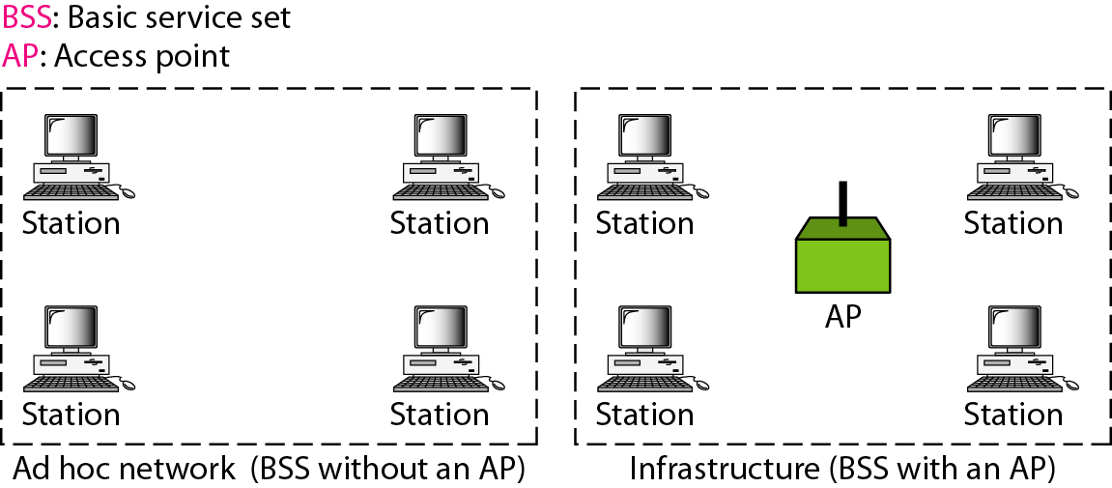
Basic service sets (BSSs)

Slide 7
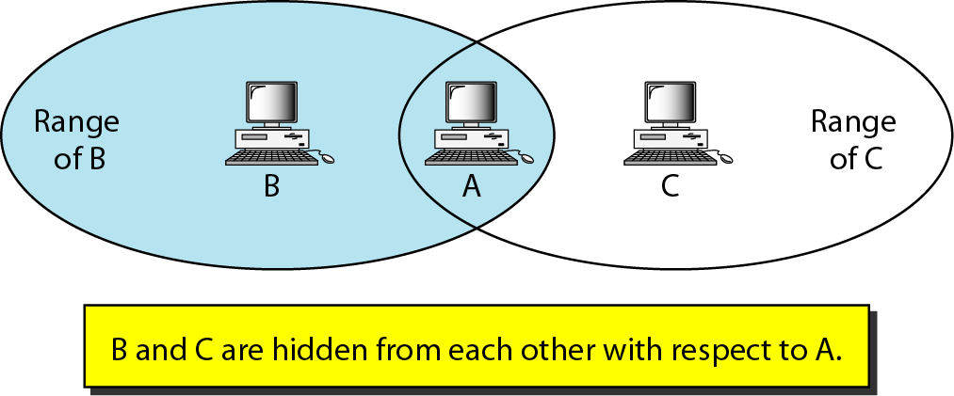
Hidden station problem

Slide 8
Note
The CTS frame in CSMA/CA handshake can prevent collision from a hidden station.

Slide 9
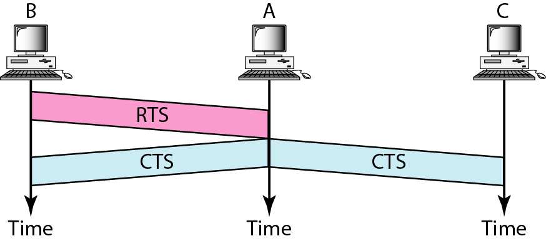
Use of handshaking to prevent hidden station problem

Slide 10
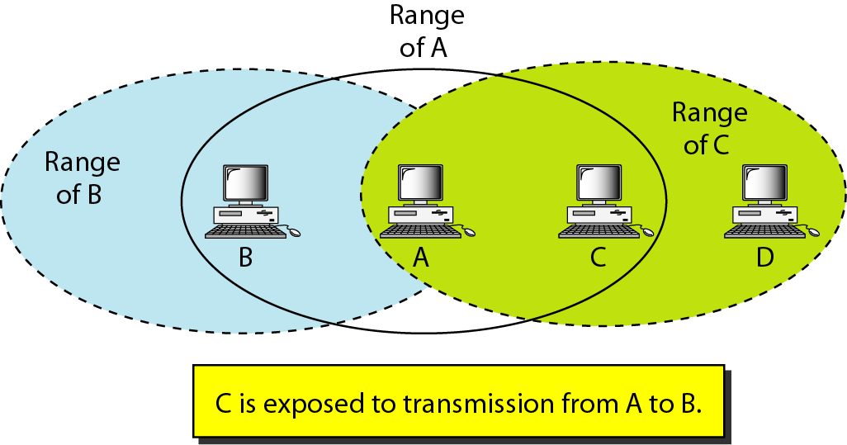
Exposed station problem

Slide 11
BLUETOOTH
Bluetooth is a wireless LAN technology designed to connect devices of different functions such as telephones, notebooks, computers, cameras, printers, coffee makers, and so on. A Bluetooth LAN is an ad hoc network, which means that the network is formed spontaneously.

Slide 12
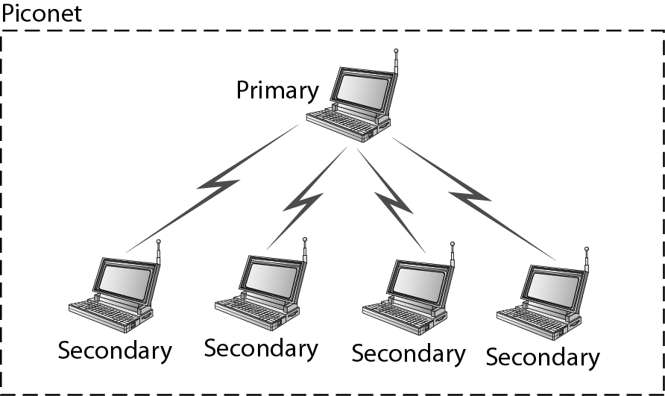
Piconet

Slide 13
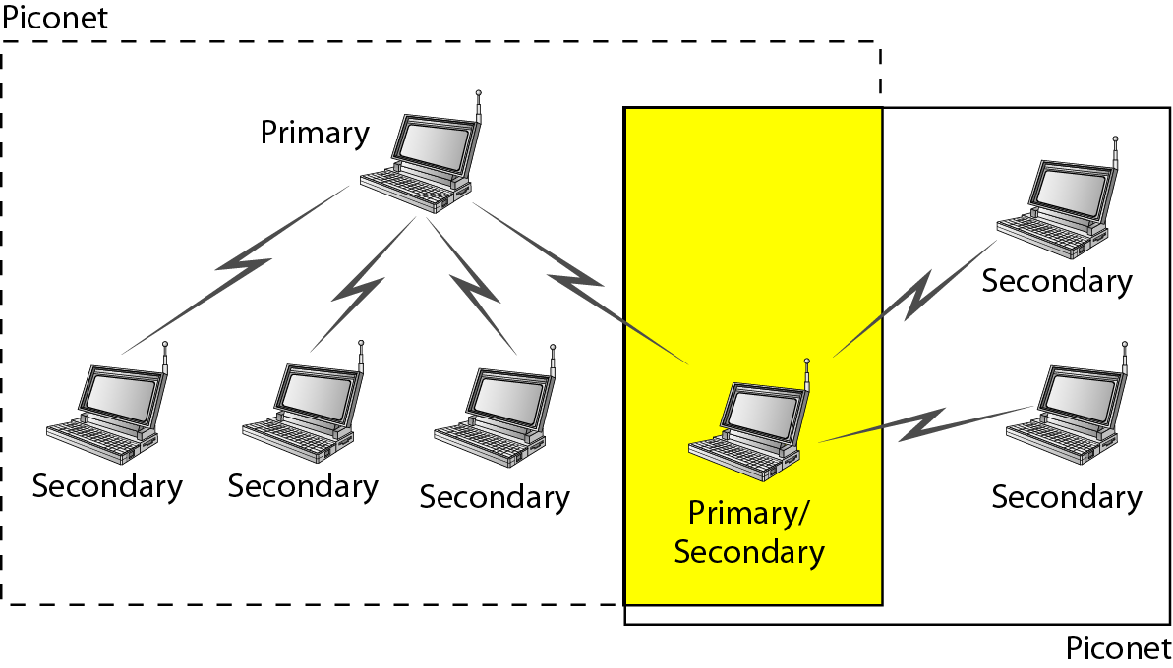
Scatternet

Slide 14
References
http://highered.mheducation.com/sites/0072967757/student_view0/chapter11/powerpoint_slides.html
https://www.tutorialspoint.com/data_communication_computer_network/data_link_control_and_protocols.htm
Data Communications and Networking by Behrouz A. Forouzan
www.mhhe.com/Forouzan

